Slide 1
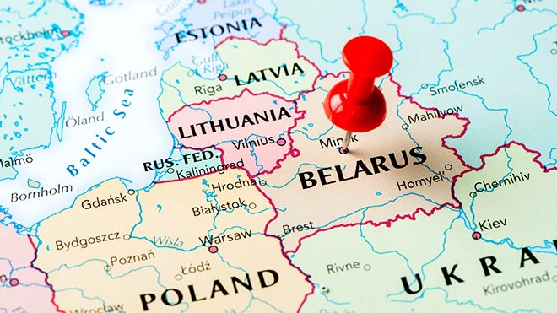
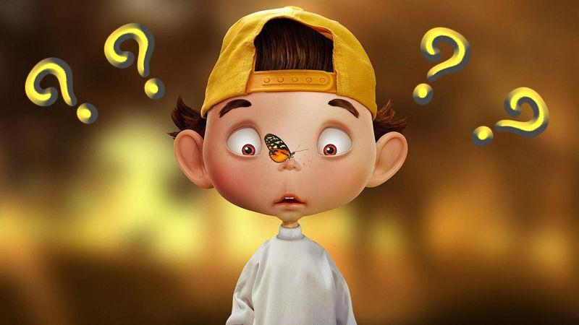
Why-kid and his magic
roly-poly inform

Slide 2
Souvenir s from Belarus

Slide 3
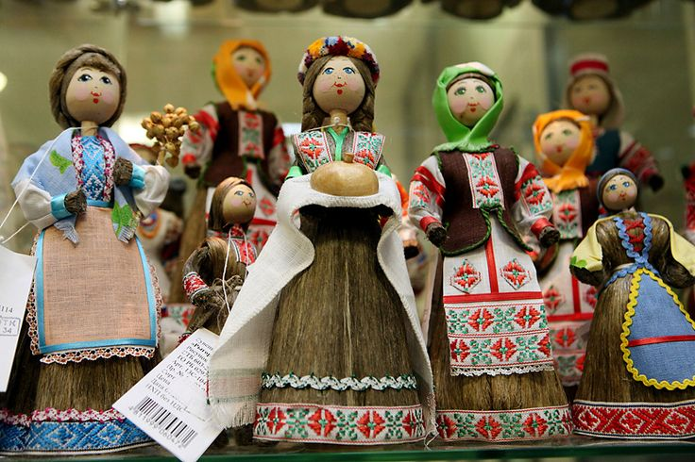
Souvenir of Belarus
What can be brought from Belarus? We can bring a lot of thing but I will tell you about the main things.

Slide 4
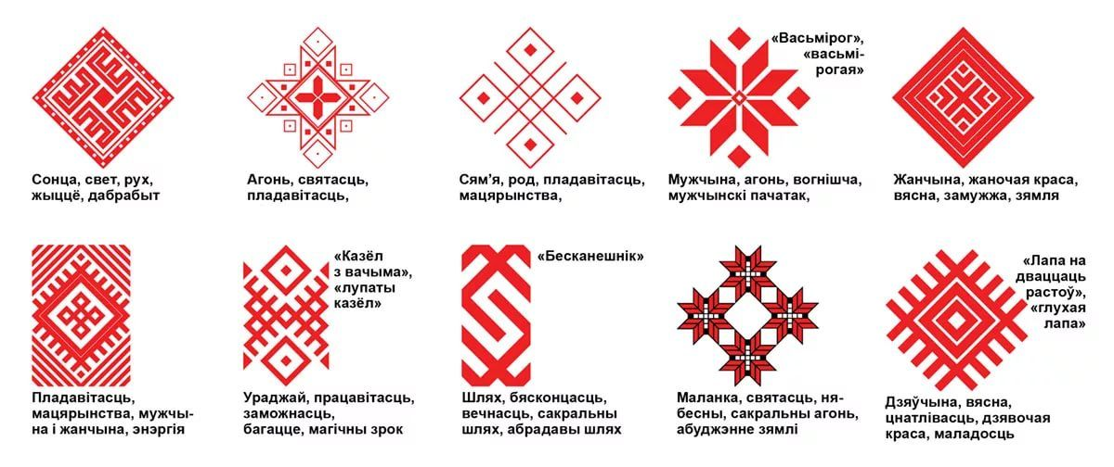
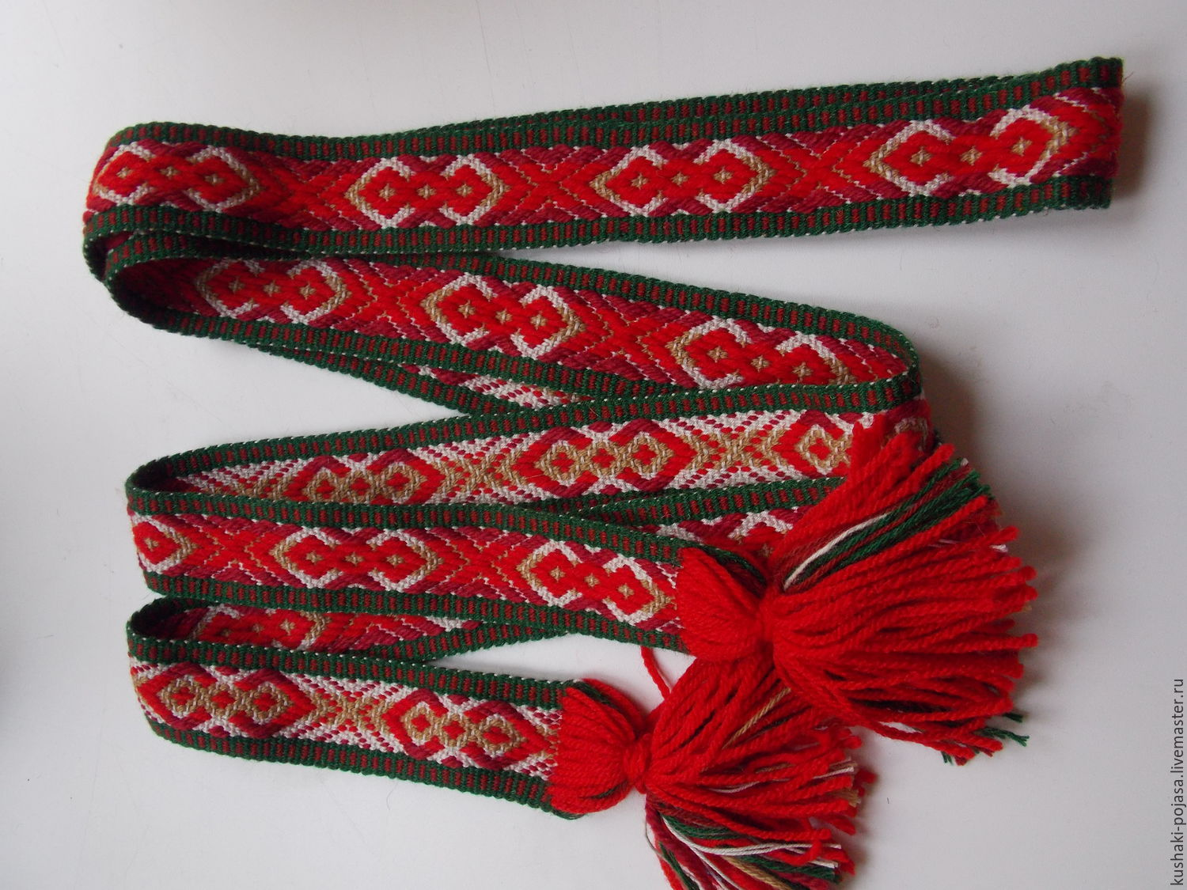
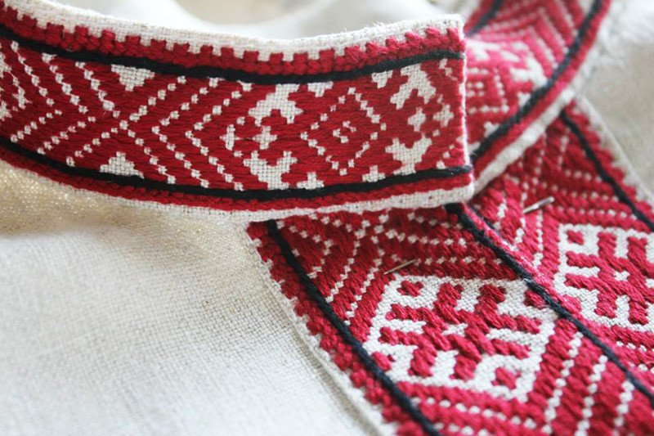
National clothes
One of the main things that should be bought is clothes with Belarusian ornament. Everyone can find an item to his liking!
It’s made of linen fabric and cools you in hot weather.
Belarusians use white and red ornament. Each pattern has a special meaning.

Slide 5
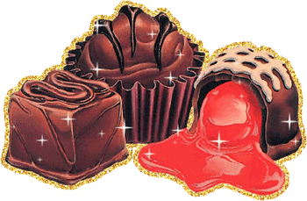
Belarusian sweets
Belarusian sweets a very tasty. The most famous manufacturers are “Komunarka” and “Spartak”.
They make chocolates and candies.
And one should sample cranberries in sugar.

Slide 6
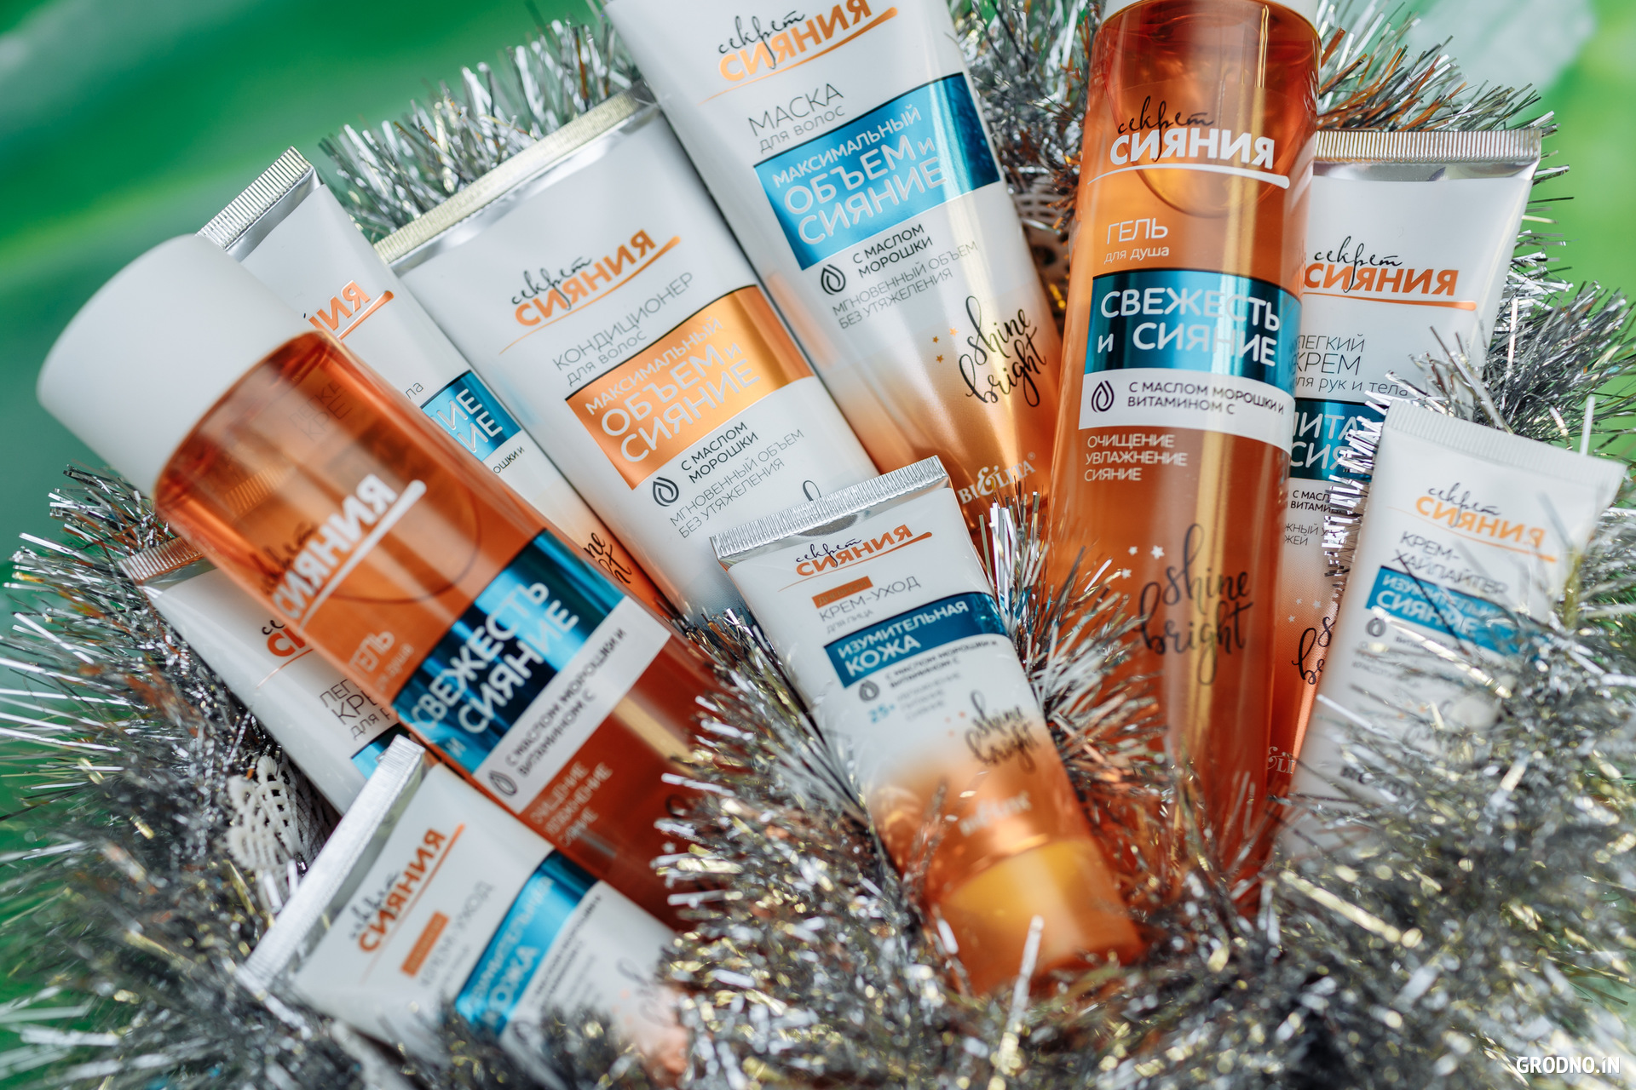
Belarusian cosmetics
Belarusian cosmetic is very popular not only with Belarusian women, but abroad.
Belita-Vitex is the leading manufacturer.

Slide 7
Milavitsa
The Belarusian company Milavitsa is quite well known. It is the largest manufacturer of women`s underwear of the highest quality.
Of course, it is most profitable to buy it in Belarus as the prices are lower.
There are shops all over the country. Almost a very major city has at least one.

Slide 8
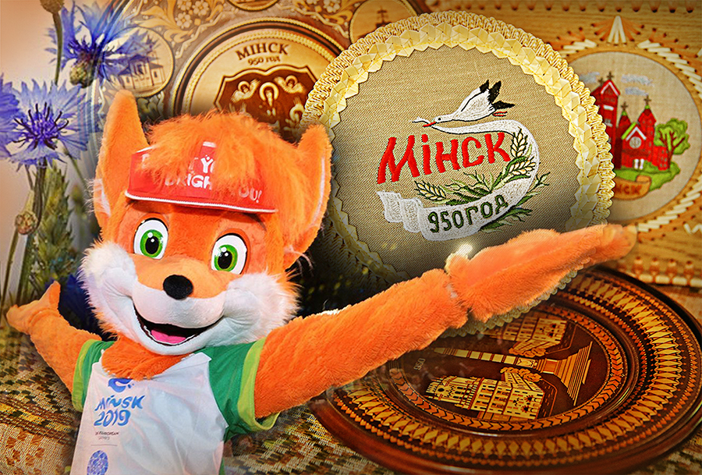
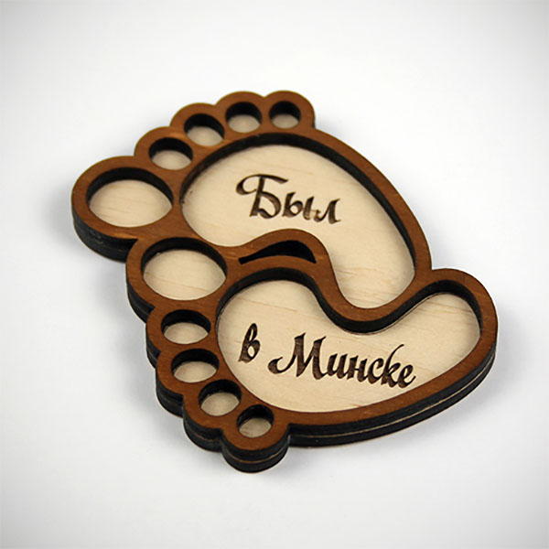
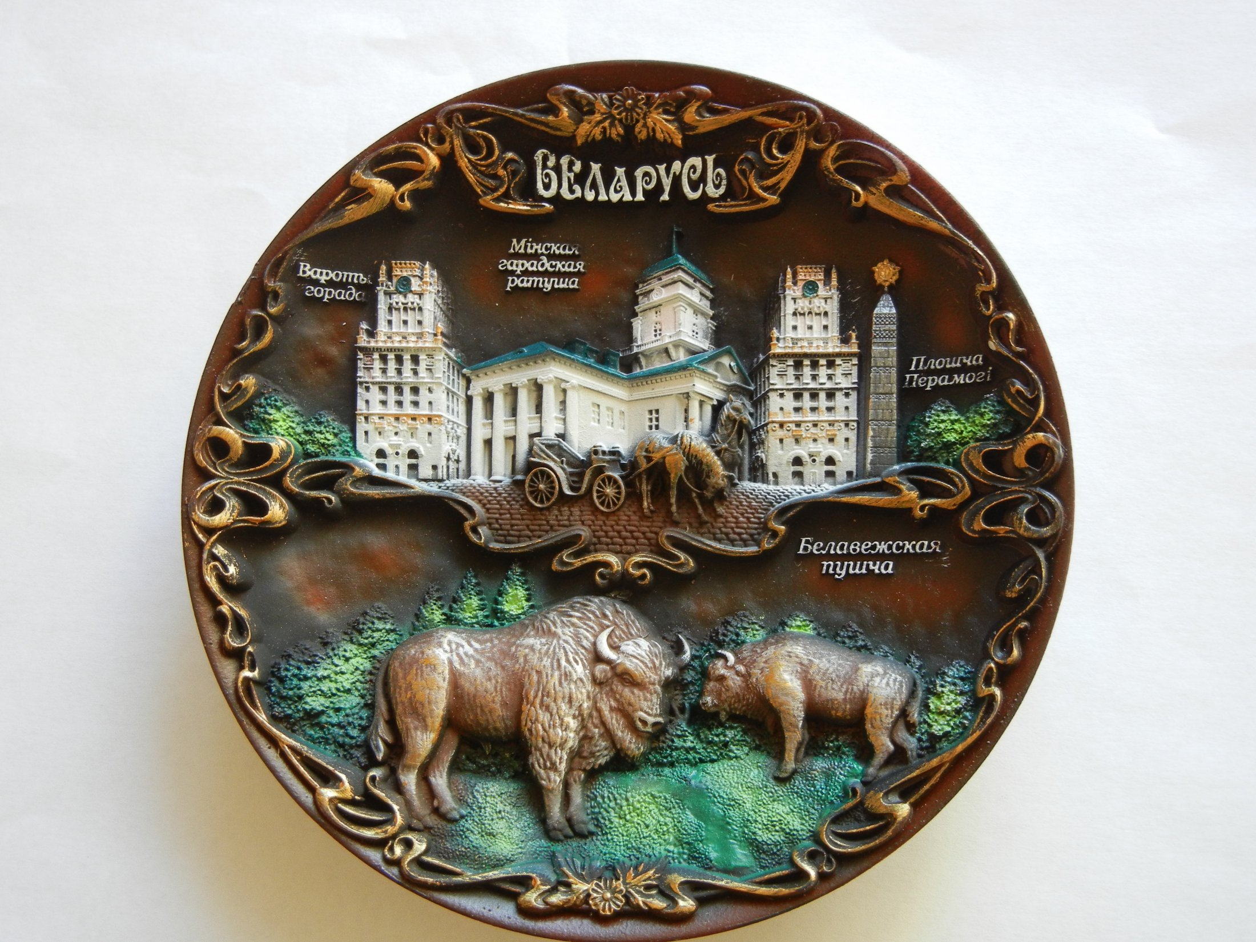
Small pleasures
Even the magnets in Belarus are not ordinary.
They are made of wood or clay and very beautiful. The choice is huge^ not only the sights of Belarus, but some huge evnts are cut on them.

