Slide 1
Why-kid and his magic Roly-poly inform

Slide 2
FATHER FROST AND SNOW MAIDEN

Slide 3
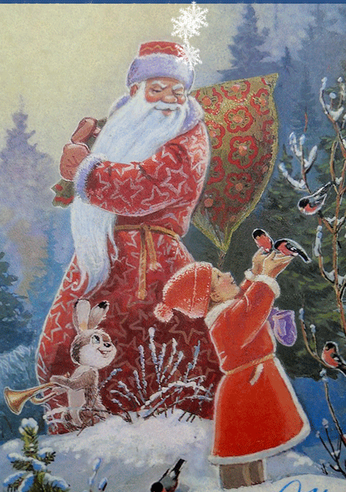
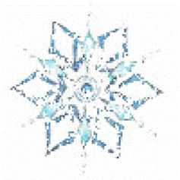
Belarusian Father Frost lives in a big wooden house in Belovezhskaya Pushcha.

Slide 4
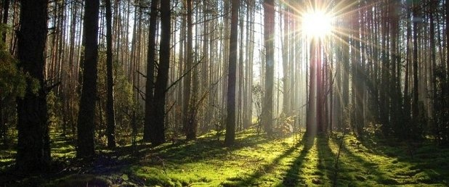
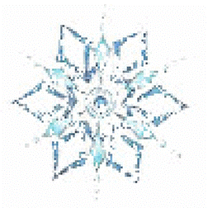
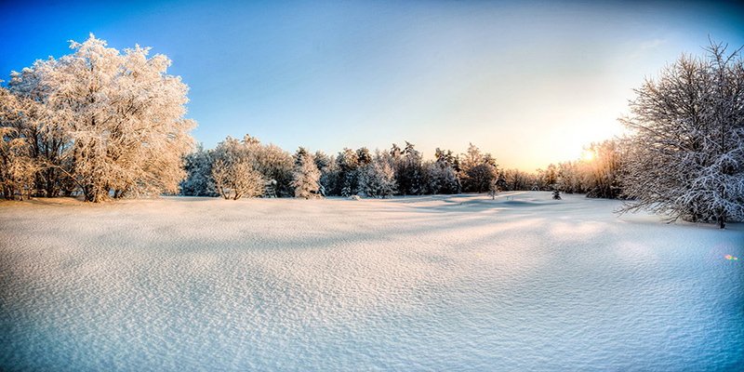
Belovezhskaya Pushcha is the largest forest in Belarus.

Slide 5
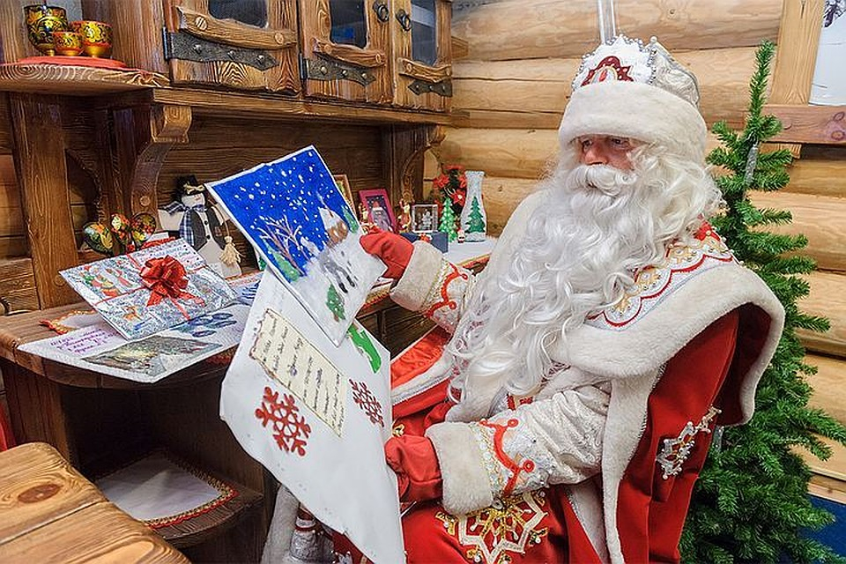
This is his address:
Belovezhskaya Pushcha
Kamenyuki village, Kamenetz district
Brest region, 225063
Belarus

Slide 6
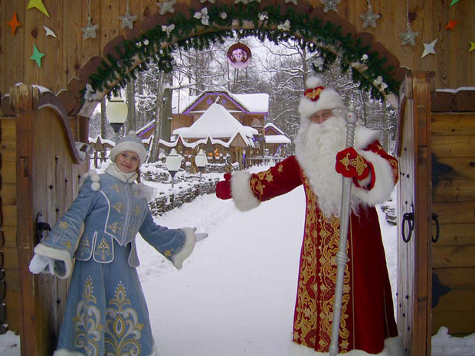
His Character:
He is strict but kind and generous.
He is also wise and sociable.

Slide 7
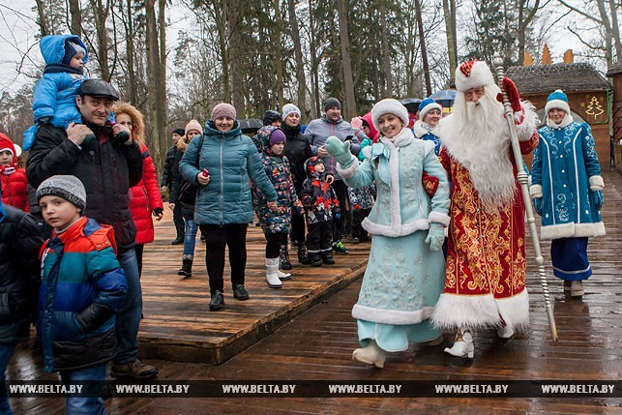
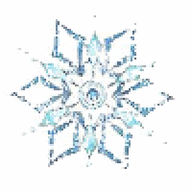
Before Christmas children from different cities and towns of Belarus come to visit him in his residence.
They sing songs, dance, tell poems in order to get a present.

Slide 8
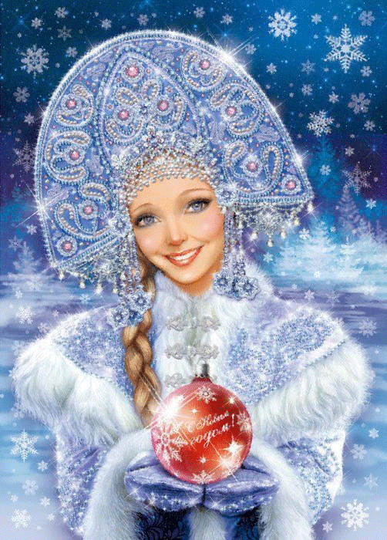
Snow Maiden is
a granddaughter
of Father Frost.

Slide 9
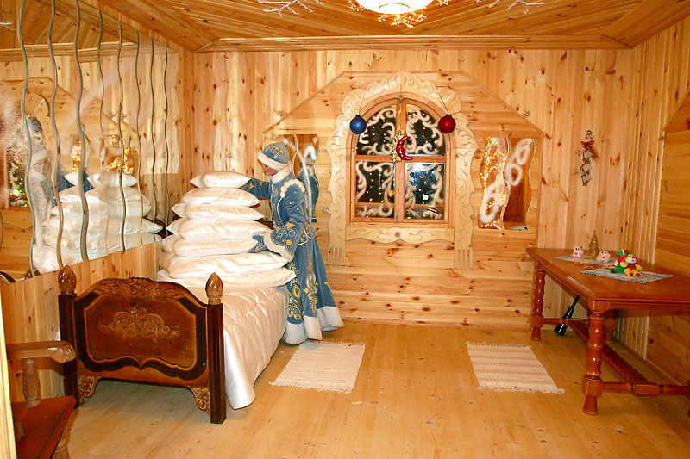
She lives in a small house not far from Father Frost's house.

Slide 10
She is intelligent, polite and responsible.
She is also friendly and helpful.

Slide 11
Snow Maiden helps her grandfather to entertain children, organize competitions and give presents to all of them.

Slide 12
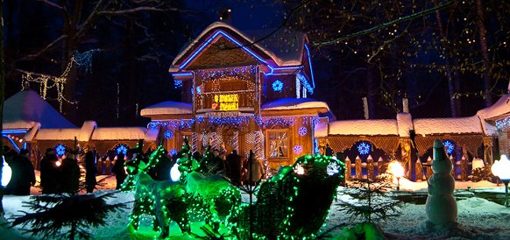
You can visit the residence of Father Frost during the whole year.

